Slide 1
Blockchain App Dev stream
WELCOME

Slide 2

Working environment.
Make sure we all share (or at least have access!) to the same working environment.

Slide 3

Computers communicate using bits and bytes.
Bitcoin messages are also just bits and bytes.

Slide 4
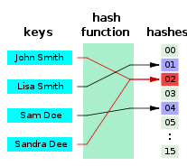
Hash functions
Oneway functions

Slide 5
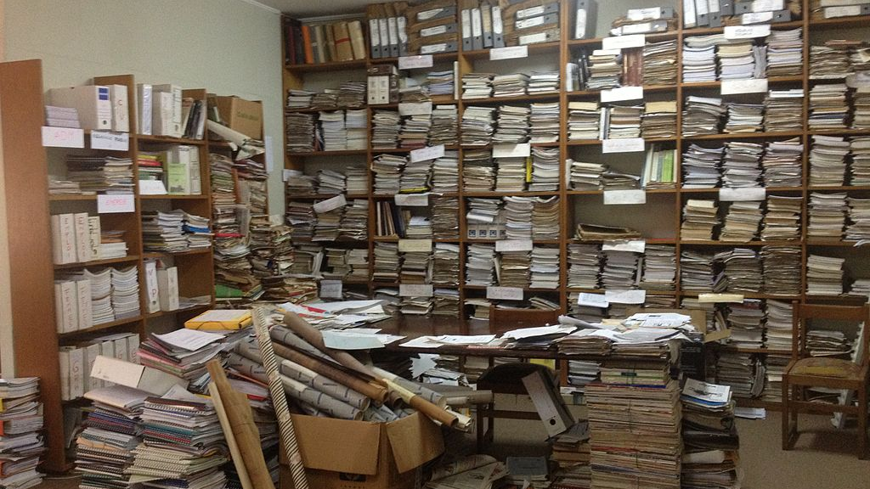
How to read the documentation
Create basic bitcoin messages
Create basic bitcoin message headers
Connect to a remote node
Wireshark and tcpdump

Slide 6

Keypairs. How they work, how to use them to sign message
Keys and addresses in the bitcoin protocol
Bitcore and some JS basics – will continue to follow us.

Slide 7

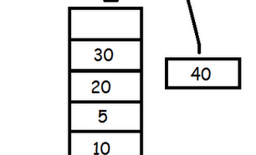
Creating a simple P2PKH transaction
Stack architecture
Scripts
Complex transactions (non standard, OP_RETURN, p2sh - optional)

Slide 8
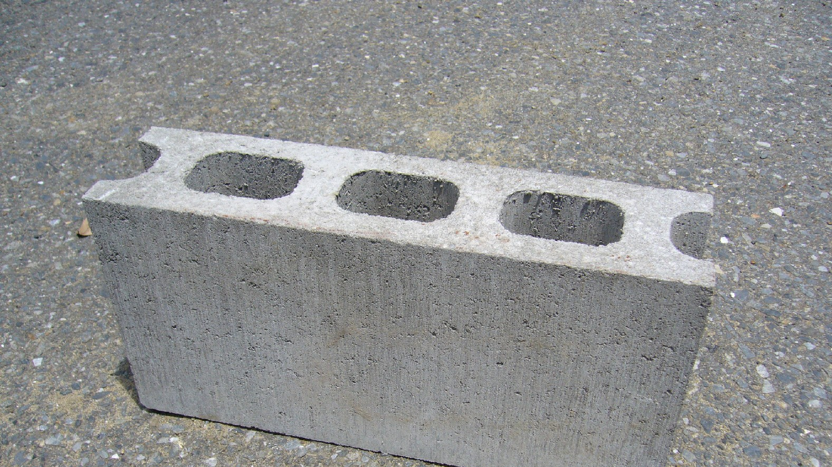
Blocks, and blockheaders
Merkle trees
Target and difficulty
DAG and consensus rules
Blocks and the blockchain

Slide 9

Sidechains
Lightning network
SegWit

Slide 10

Moving to Ethereum General talk about ethereum, why it was created, general concepts and ideas.

Slide 11

Write smart contract using Solidity
Basic concepts in smart contracts and the blockchain architecture
Deploying basic smart contracts
Variables and functions

Slide 12
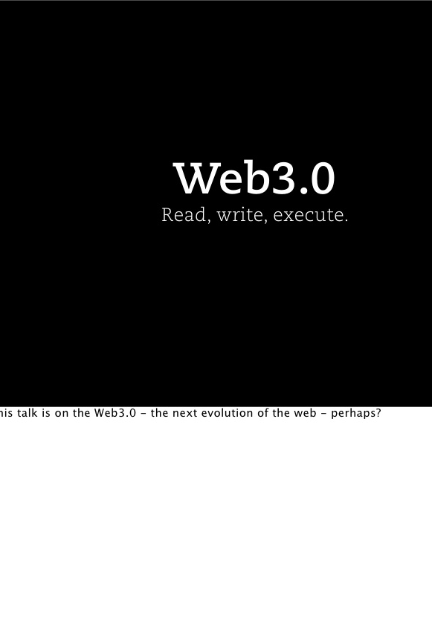
Web 3 JS library
ABI
Callback functions
Deploying contracts

Slide 13
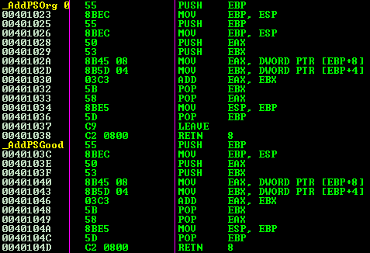
Inline assembly
Ethereum VM
Basic OP_CODES

Slide 14

Libraries
Upgradable contracts
Some security issues

